Slide 1
Progress Report
Team Toyota

Slide 2
Project Overview
A mobile cloud hosting multiple smart vehicles to share information and communicate with one another in real-time.
Reduced communication delay
Reduced spectrum costs
Amply expanded range of applications
Reduced network latency by offloading processing jobs to local nodes
Mobile agents can be both users as well as service providers
Notes:
ambarish

Slide 3
Project Goal
Our goal is to provide a middle tier application that enables distributed querying and distributed processing capabilities on network of mobile nodes.
Notes:
ambarish

Slide 4
Planned Tasks to deliver
Real-time distributed querying API
Real-time distributed processing API
Deliverable components:
Demo
Source code
Technical report
Notes:
ambarish

Slide 5
Distributed Querying
Distributed querying API required
Facilitate information gathering from vehicles nearby/same locality
Use-cases such as Traffic Safety, In-vehicle entertainment

Slide 6
Distributed Querying- using Jgroups
Toolkit for reliable messaging
Create clusters of nodes
Detect of new,left/crashed nodes
Point-to-multipoint and point-to-point
Supports UDP(IP Multicasting) or TCP

Slide 7
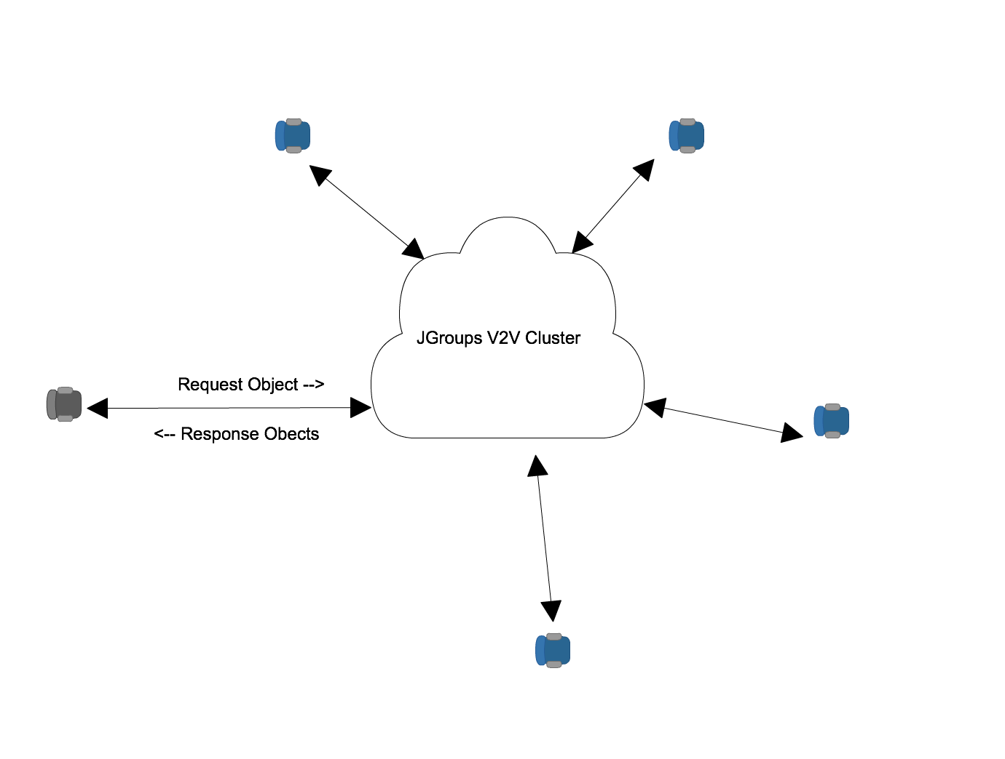
Distributed Querying-Jgroups
Jgroups RPCDispatcher

Slide 8
Distributed Querying-APIs
This is how simple it is !!!
Starting the cluster
JgroupsRpc jgroupsRpc = JgroupsRpc.getInstance()
jgroupsRpc.start();
Querying the cluster
RspList<VehicleDistance> rsp_list=jrpc.dispatch(ResponseMode.GET_ALL, 5000, new VehicleDistance(), VehicleDistance.class);
List<VehicleDistance> it= rsp_list.getResults();

Slide 9
Distributed Computing
Our technology stack must fulfill client’s need for real-time, distributed computing infrastructure.
Stacks considered: OpenStack, Apache Storm, Hyrax

Slide 10
Distributed Computing
Technology Stacks Considered:
 | Pros | Cons
OpenStack | well-documented and widely used cloud computing platform Scalable, reliable, fault-tolerant | No real-time distributed processing capability
Apache Storm | Real-time distributed processing capability Scalable, reliable, fault-tolerant, and fast | Not as widely used as OpenStack (doesn’t have MarketPlace for plug-ins,etc)
Hyrax | Specifically developed to enable mobile cloud computing. Already works on Android CMU product | Lack of documentation and support group. Difficult to get hold of the source code In beta stage

Slide 11
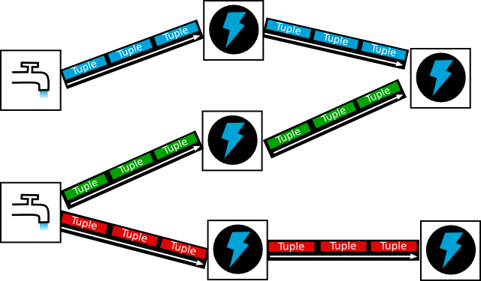
Distributed Computing
Topology
Notes:
Tuple: Core unit of data. Immutable set of key/value pairs.
Streams: Unbounded sequence of tuples
Spout: source of streams. Responsible for data input.
Bolts: Core functions of a streaming computation. Receives tuples and does computation on them.
Topology: Is a description of a workflow. It defines how the code you write is put together and executed. Storm executes spouts and bolts as individual tasks that run in parallel on multiple machines.

Slide 12
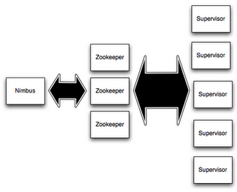
Distributed Processing
Storm Cluster
Notes:
Nimbus handles scheduling of tasks in the cluster. Supervisor supervises the process that actually executes your code. Zookeeper handles cluster management.
Topology submitter uploads topology (jar file to the Nimbus)
Nimbus calculates assignments and sends to Zookeeper.
Supervisor nodes receive assignment info from Zookeeper
Supervisor nodes download topology from Nimbus
Supervisor spawn workers (JVM processes) to start the topology
How it achieves parallelism:
Each supervisor is a machine. And multiple JVMs (workers) are run on each machine (supervisor) and uses many threads per JVM (executors)
Reference:
http://www.slideshare.net/ptgoetz/storm-hadoop-summit2014
http://jansipke.nl/storm-in-pictures/

Slide 13
Distributed Computing
Storm CV
StormCV API
StormCV Models
Serializers
OpenCV Operations
Apache Storm API
OpenCV API

Slide 14
Demo
StormCV demo running on local cluster

Slide 15
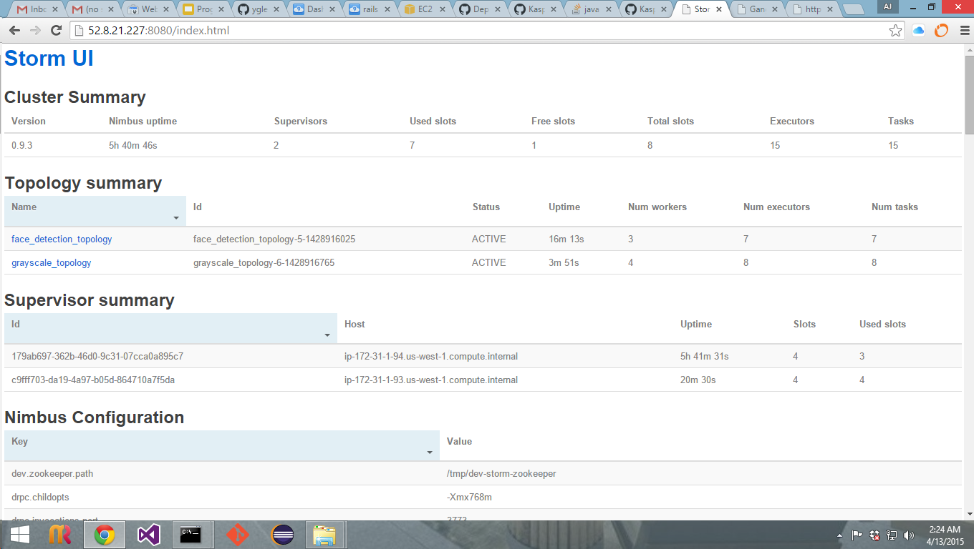
Storm Remote Cluster

Slide 16
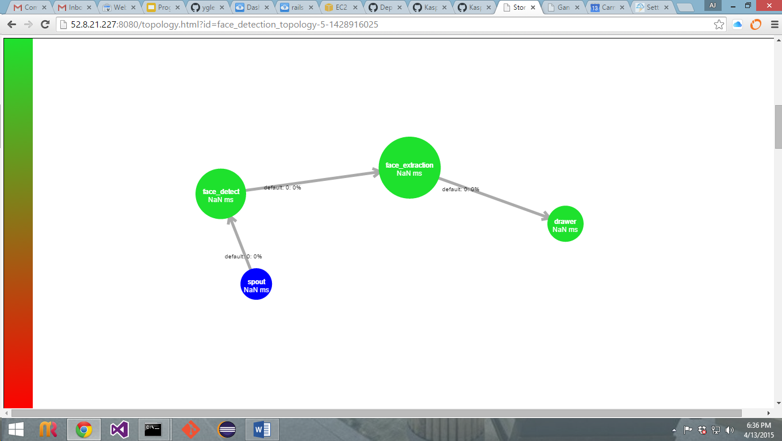
Topology Visualization

Slide 17
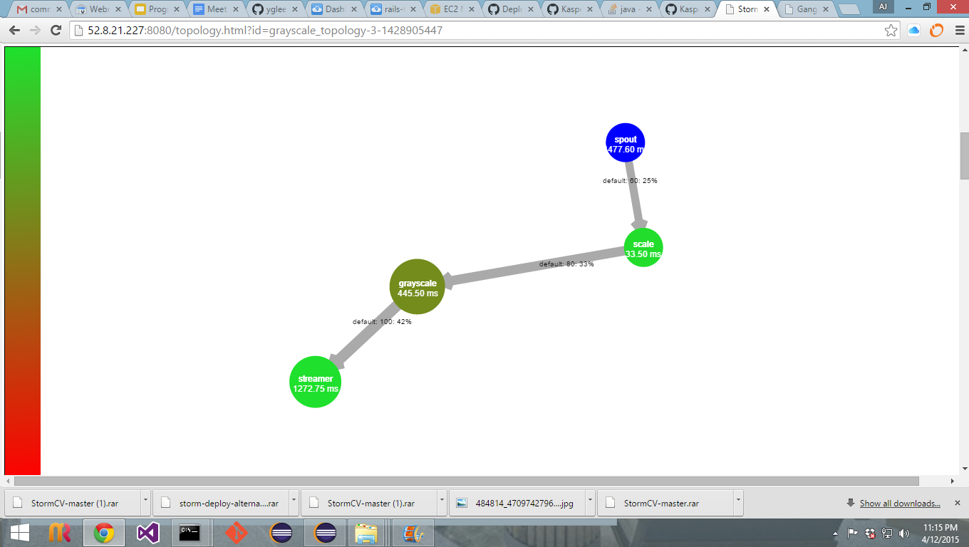
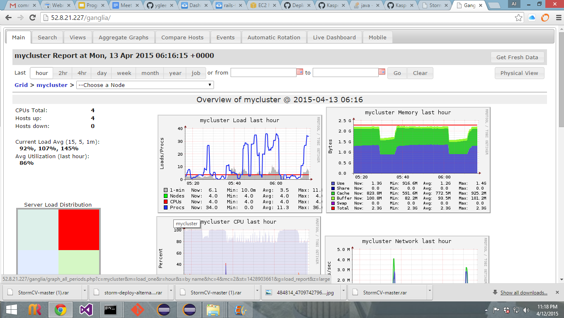
Ganglia Performance UI

Slide 18
Health of the Project Progress
Sprint 1
Sprint 2
Sprint 3
Completed an evaluation and decided to use Apache Storm
with AWS
Github repository created for Apache Storm
Included a car recognition feature (StormCV) as a stretch goal
API ideas discussed, and decided to use JGroups
API and doc developed for distributed querying
AWS set up and manual integration testing began
Shared the initial API documentation with another team

Slide 19
Plan for rest of the project
Sprint 4
Set up the proof of concept infrastructure and verify with a demo application
Attempt to complete a prototype for StormCV car detection feature
Provide an API documentation for the prototype infrastructure

Slide 20
Questions?

